Slide 1
A/B TESTING ANALYSIS FOR
E-COMMERCE WEBSITE USING TABLEAU
BY SUNDAY ADAMS OMALE

Slide 2
INTRODUCTION
DigitalPath Innovations, a leader in digital marketing solutions, conducted an A/B test to evaluate two versions of its website (Version A and Version B) to enhance user engagement, improve conversion rates, and increase overall customer satisfaction.
This analysis aims to assess which webpage version performs better across key user engagement metrics, including time spent on the site, pages viewed, and actions taken.
By employing data-driven insights, this report will provide actionable recommendations to inform future iterations of the website’s design, ultimately improving DigitalPath Innovations' ability to engage users and optimize conversion rates.

Slide 3
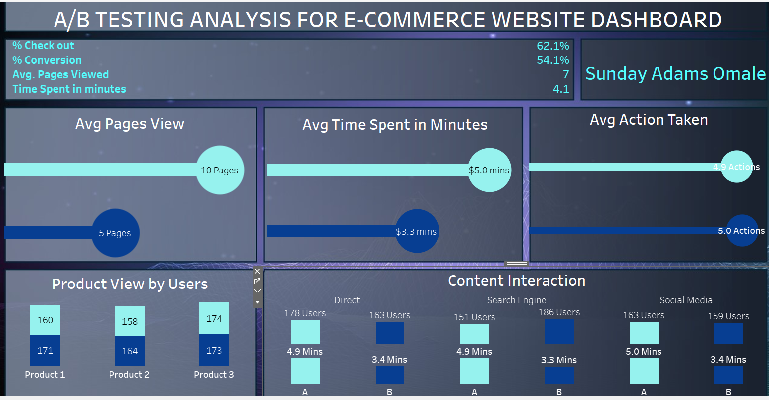

Slide 4
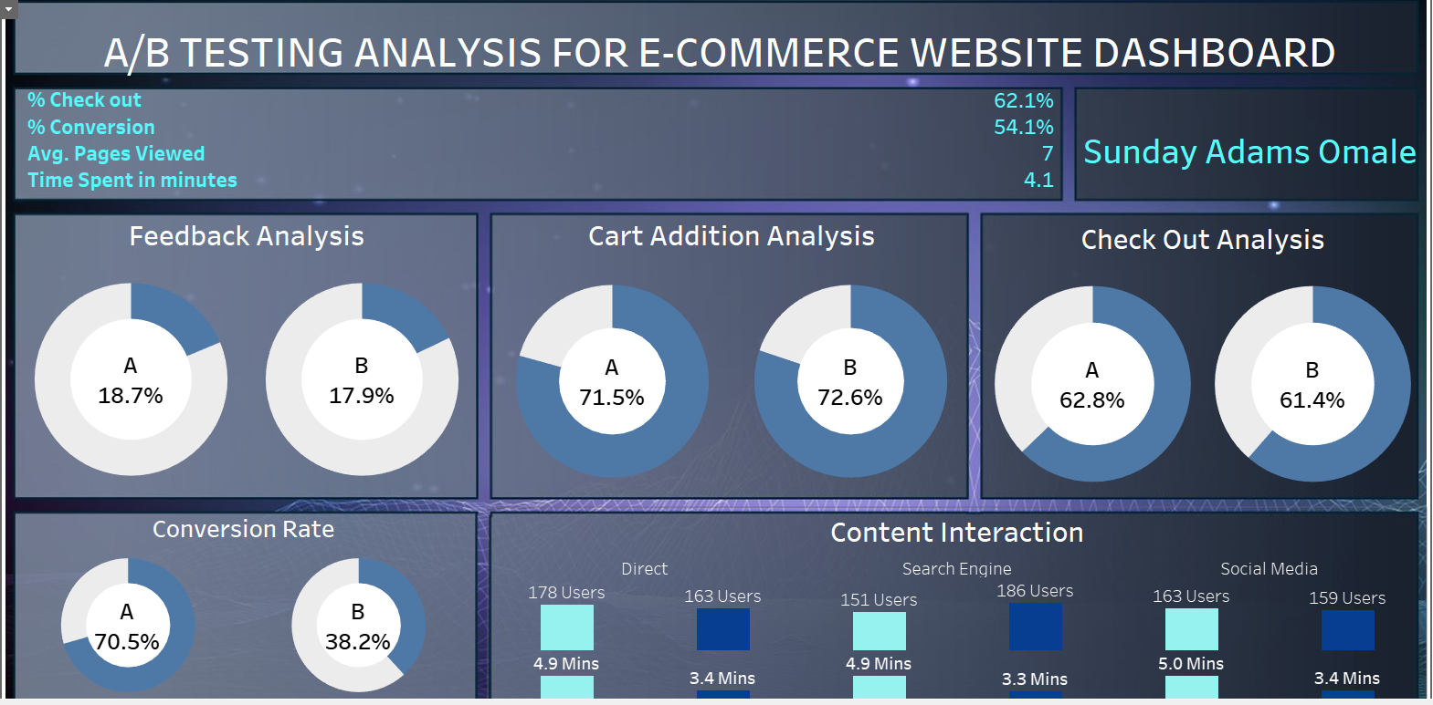

Slide 5
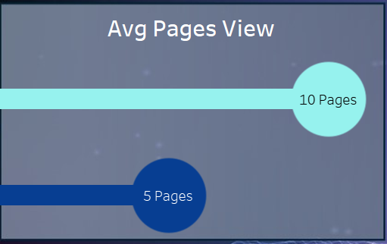
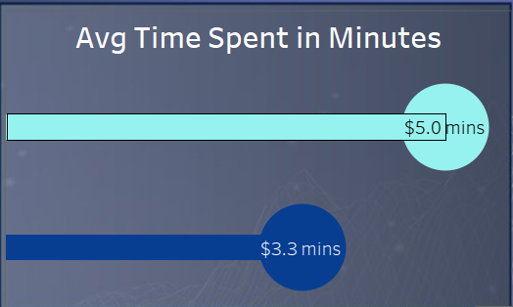
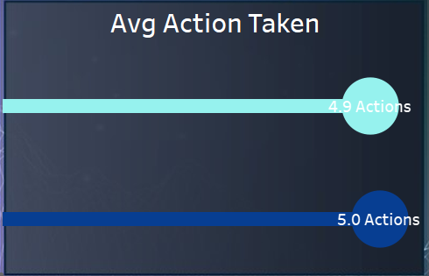
1. Engagement Metrics Analysis Insights
Average time Spent Analysis:
This helped highlight differences in user engagement duration between the two versions.
Pages Viewed and Actions Taken:
Version A shows a higher average time spent and more pages viewed, it is higher than the industry standard of 2-3 minutes spent on 2- 5 pages viewed per session

Slide 6
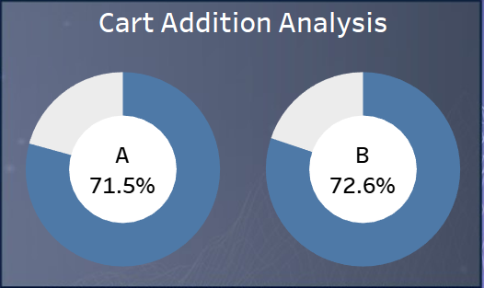
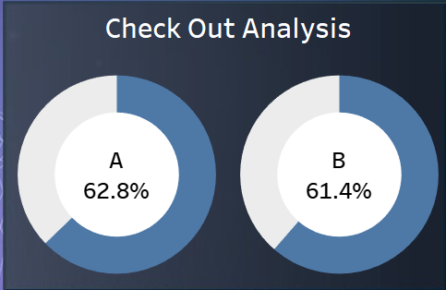
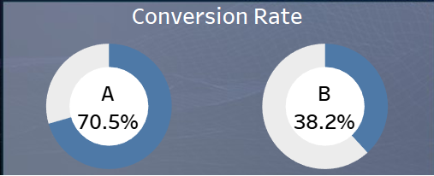
2. Conversion Rate Optimization Insights
Cart Addition Analysis:
This shows the progression in percentage from product view to checkout initiated.
Check Out Analysis:
From the chart, there was more drop-off for version B than A in the conversion process.
Conversion Rate:
Overall, the conversion rate is higher than the industry standard of 2-% for overall conversion, 10% for checkout initiation, and 50% for purchase completion.
Version B performs better in initiating checkout but falls behind in completion.

Slide 7
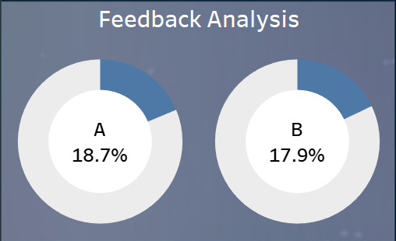
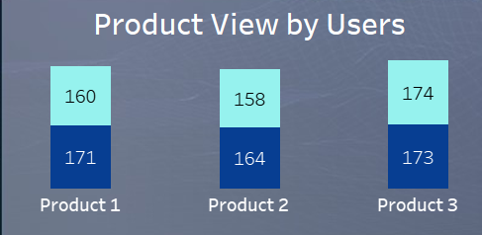
3. User Feedback Analysis Insights
Feedback Rate Analysis:
This shows the correlation between feedback submission and the webpage version viewed to gauge user satisfaction and engagement.
Feedback Rate by Version Analysis:
Version A users submitted more feedback ratings than version B users.

Slide 8
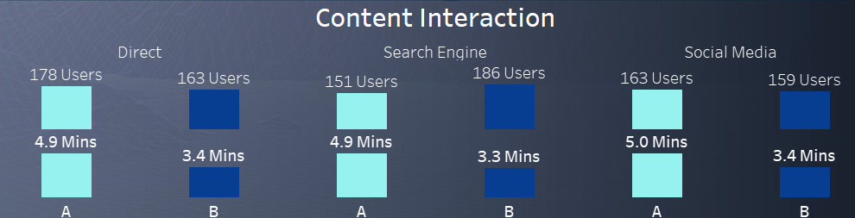
4. Content Interaction Analysis Insights
Analysis:
This shows how each version influences content interaction focusing on direct, search engine, and social media interaction.
Direct interaction is higher in version A and search engine is higher in version B.

Slide 9
Recommendations Based on Insights
Engagement Metrics:
Version B shows higher engagement metrics (longer time spent on the site and more pages viewed), DigitalPath Innovations should consider adopting its design elements more broadly. This could involve adopting its layout, navigation structure, or content organization, which seems to hold user attention longer.
Run a further usability test to understand which design aspects of Version B are driving higher engagement and apply these insights to enhance the user journey.
Conversion Rate Optimization:
Analysis reveals a higher drop-off in Version B at the checkout steps, the checkout process for Version B should be streamlined. Possible friction points (e.g., form complexity or unclear calls-to-action) should be addressed to make it easier for users to complete purchases.
Simplify the checkout process by reducing unnecessary fields or steps, improving button clarity, and ensuring that any supporting content is easy to find.

Slide 10
Recommendations Based on Insights
User Feedback:
Version A has a higher feedback submission rate or better user ratings, DigitalPath should focus on replicating its design features to drive satisfaction and engagement. Feedback is a key indicator of user sentiment, so improving features that lead to higher feedback rates can create more touchpoints for capturing user opinions.
Use automated prompts or simplified forms to encourage more user feedback, especially if Version A’s feedback mechanism proves more effective. This will provide more data to make informed design changes.
Content Interaction:
Users on Version A are more likely to view Product 3, consider improving the visibility and placement of Product 3 content on Version B to increase engagement.

Slide 11
Thank you

